Slide 1

Cache Hierarchy Optimizations for Graph Analytics
CS230: Digital Logic Design & Computer Architecture
Karan Godara (210050082)
Isha Arora (210050070)
Shantanu Welling (210010076)

Slide 2
Baseline Configuration
CACHE | CONFIGURATION
L1 I-CACHE | 64 SET, 8 WAY
L1 D-CACHE | 64 SET, 12 WAY
L2 CACHE | 1024 SET, 8 WAY
LAST LEVEL CACHE | 2048 SET, 16 WAY
Traces Used : sssp-14 and bfs-14
Base replacement policy : LRU
No prefetcher for all cache levels in Base configuration

Slide 3
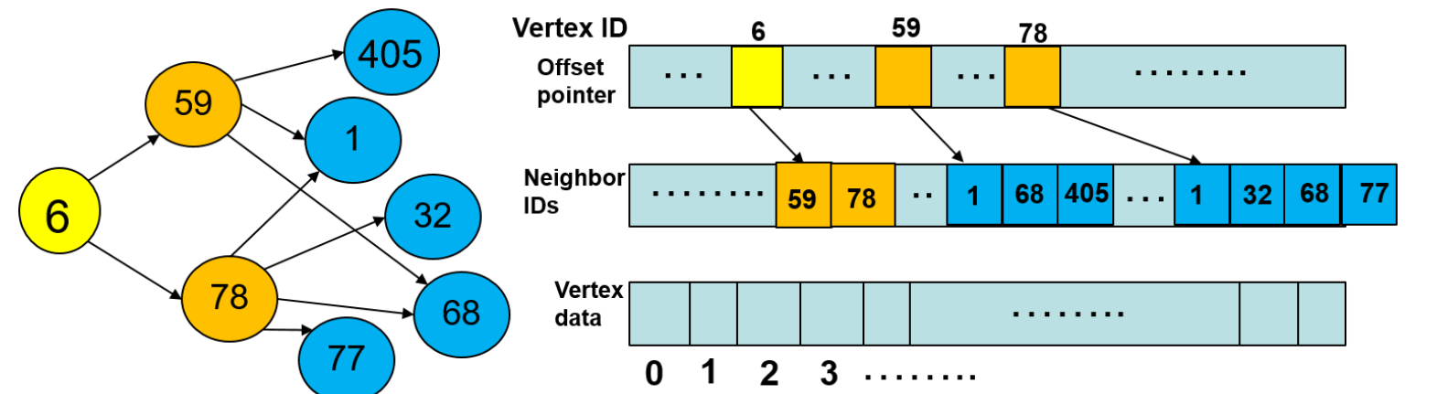
Data Types in Graph Traces
Structure data: the neighbor ID array.
Property data: the vertex data array
Intermediate data: any other data.

Slide 4
Baseline Results
BFS Trace SSSP Trace
L1D Miss Rate: 13.66%
L2C Miss Rate: 58.88%
LLC Miss Rate: 90.56%
IPC: 0.1697
L1D Miss Rate: 22.06%
L2C Miss Rate: 61.64%
LLC Miss Rate: 34.56%
IPC: 0.2909

Slide 5
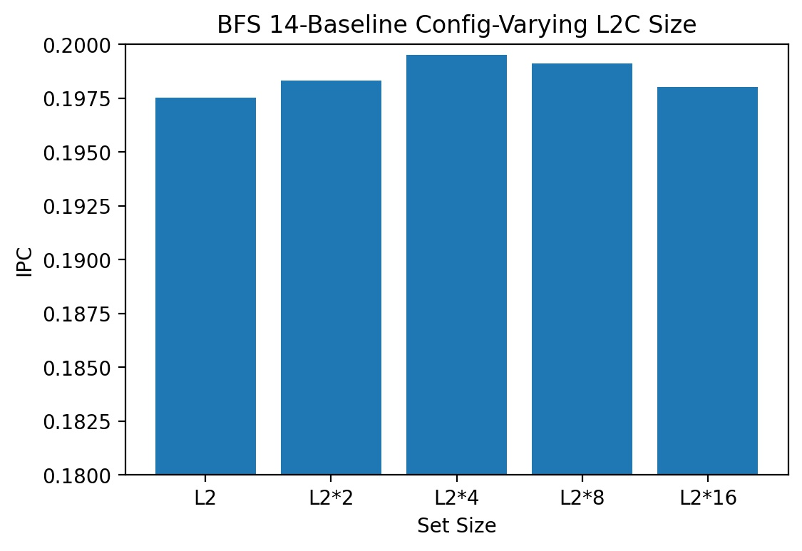
Shall we increase the cache size?
L2C Size ↑↑ IPC No Change ☹

Slide 6
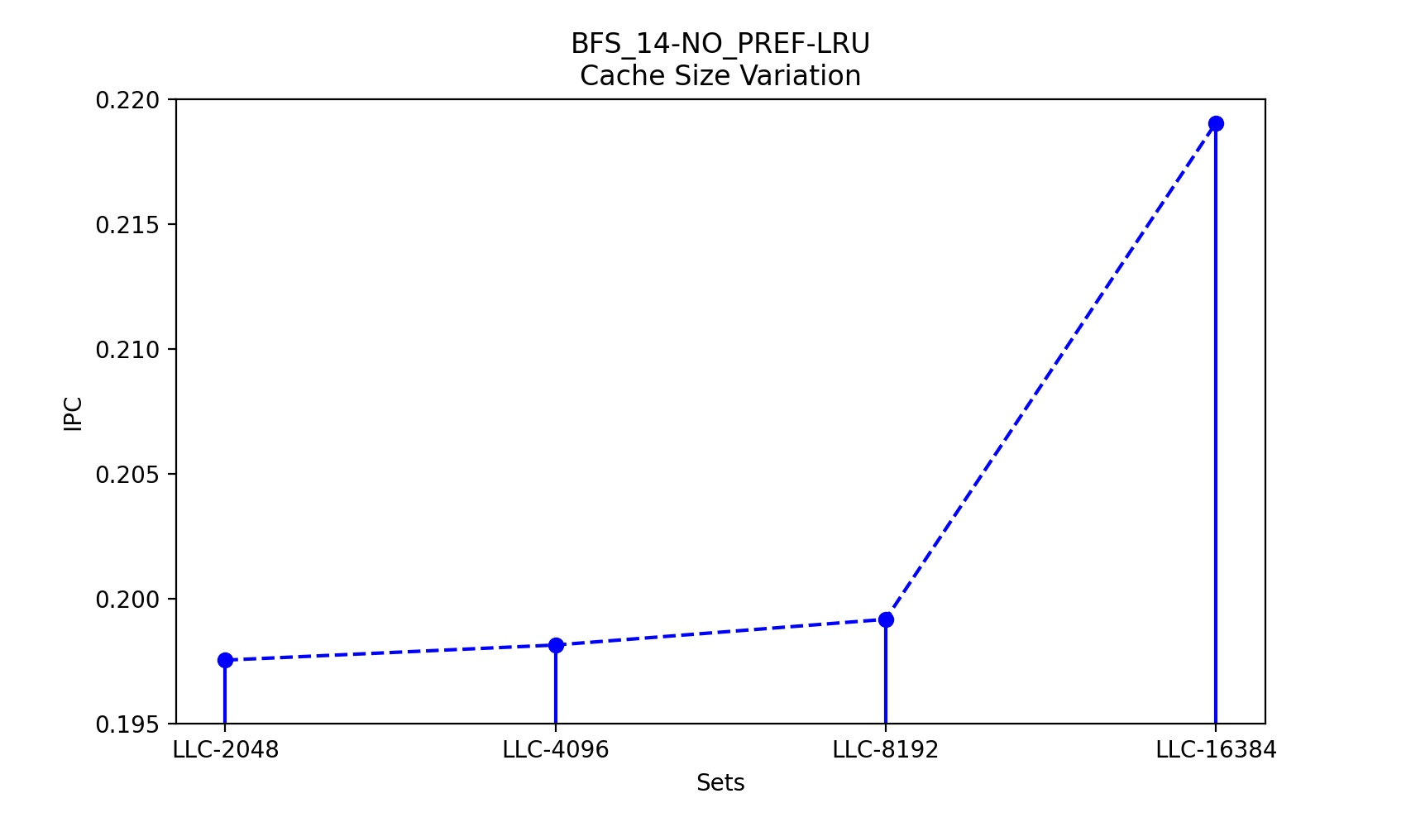
What about LLC😲? Any Hopes?
LLC Size ↑↑ IPC ↑↑
Increasing L2C size doesn't affect IPC significantly, but increasing LLC size shows a significant increase in IPC
Reuse distance either very short or very long

Slide 7
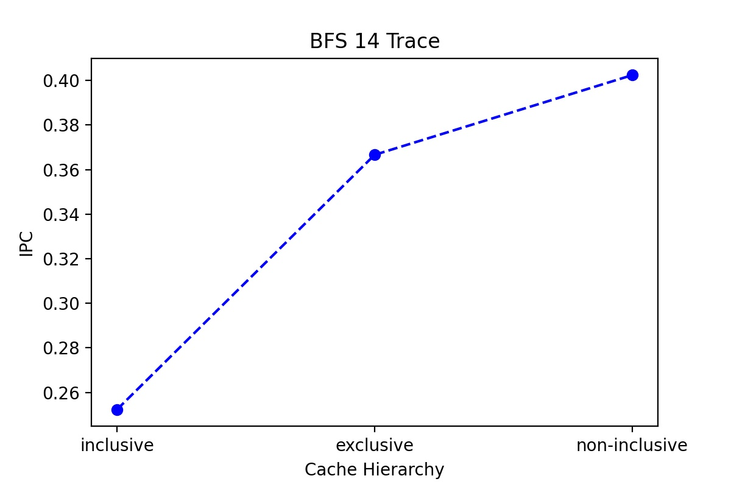
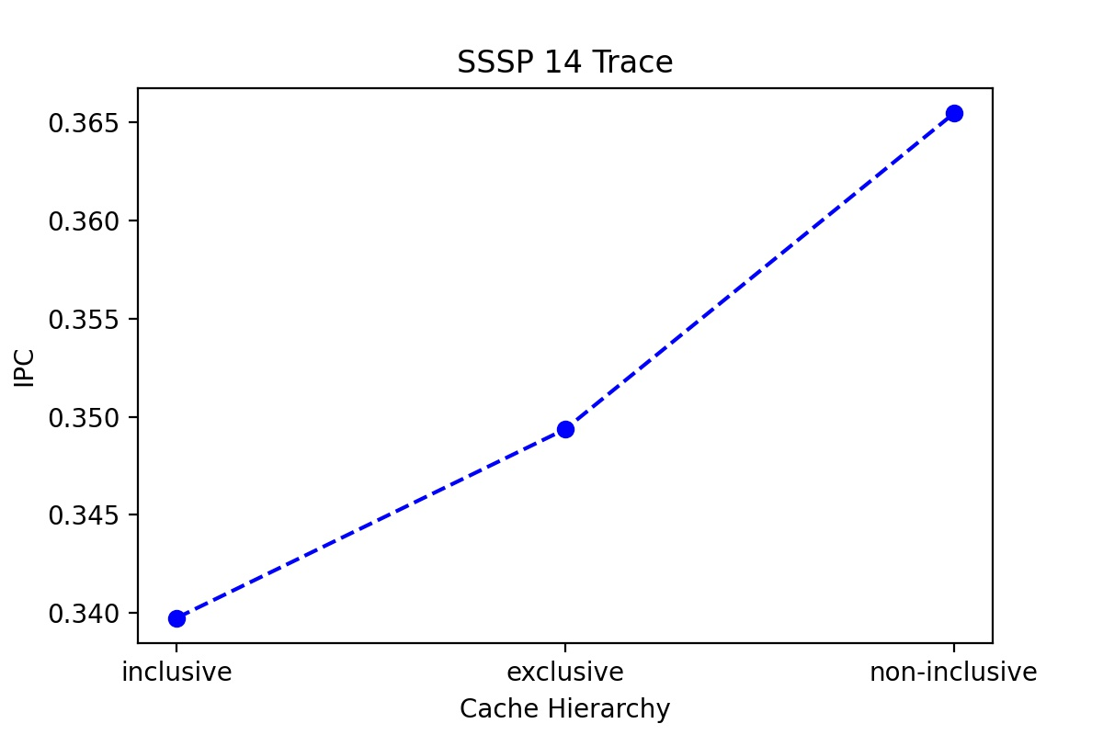
Maybe change cache hierarchy?
Clearly non-inclusive cache hierarchy performs better for graph analytics than exclusive or inclusive cache hierarchy on a single core processor

Slide 8

So what to do now?
How to make sure reused data stays in the cache? How to increase the hit-rate of caches?
Attempt-> Use better replacement policies 🤩
How to utilize L2C effectively?
Attempt-> Use prefetchers 🤩

Slide 9
Replacement policies
What are our options now?
Heuristic Policies | Non-Heuristic Policies
Most Recently Used (MRU) | Signature based Hit Predictor (SHIP)
First In First Out (FIFO) | Mockingjay
Least Frequently Used (LFU) | Hawkeye
Random
Least Recently Used (LRU)
Dynamic Re-Reference Interval Prediction (DRRIP)
Static Re-Reference Interval Prediction (SRRIP)

Slide 10
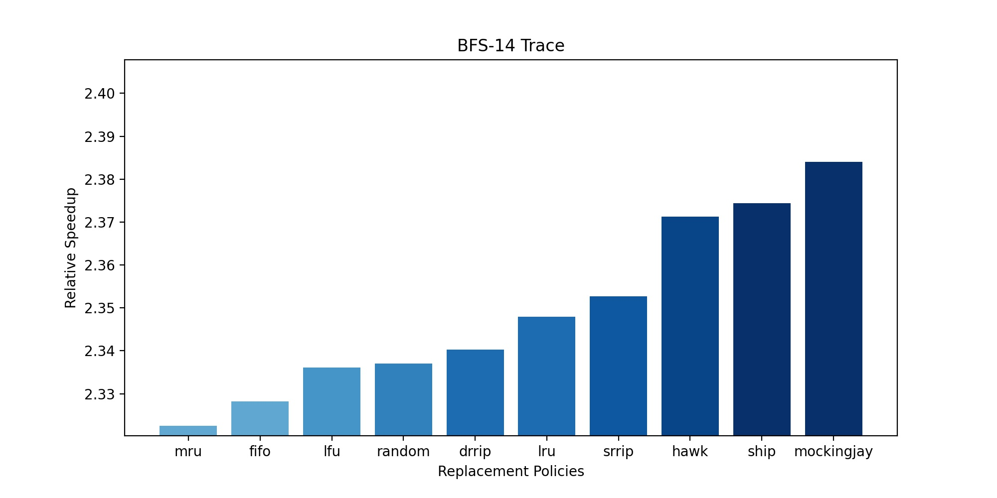
Non-heuristic >>> Heuristic

Slide 11

Where to prefetch?
L2 Cache:
No risk of cache pollution
Technique to make the under-utilized L2 cache useful

Slide 12
Prefetchers
What are our options now???
Next Line Prefetcher
Berti: Local Delta Prefetcher
Signature Path Prefetcher (SPP)
T-Skid Prefetcher
5. Bouquet of Prefetchers (IPCP)
6. Sangam Prefetcher
7. Best Offset Prefetcher (BOP)
8. Pangloss

Slide 13
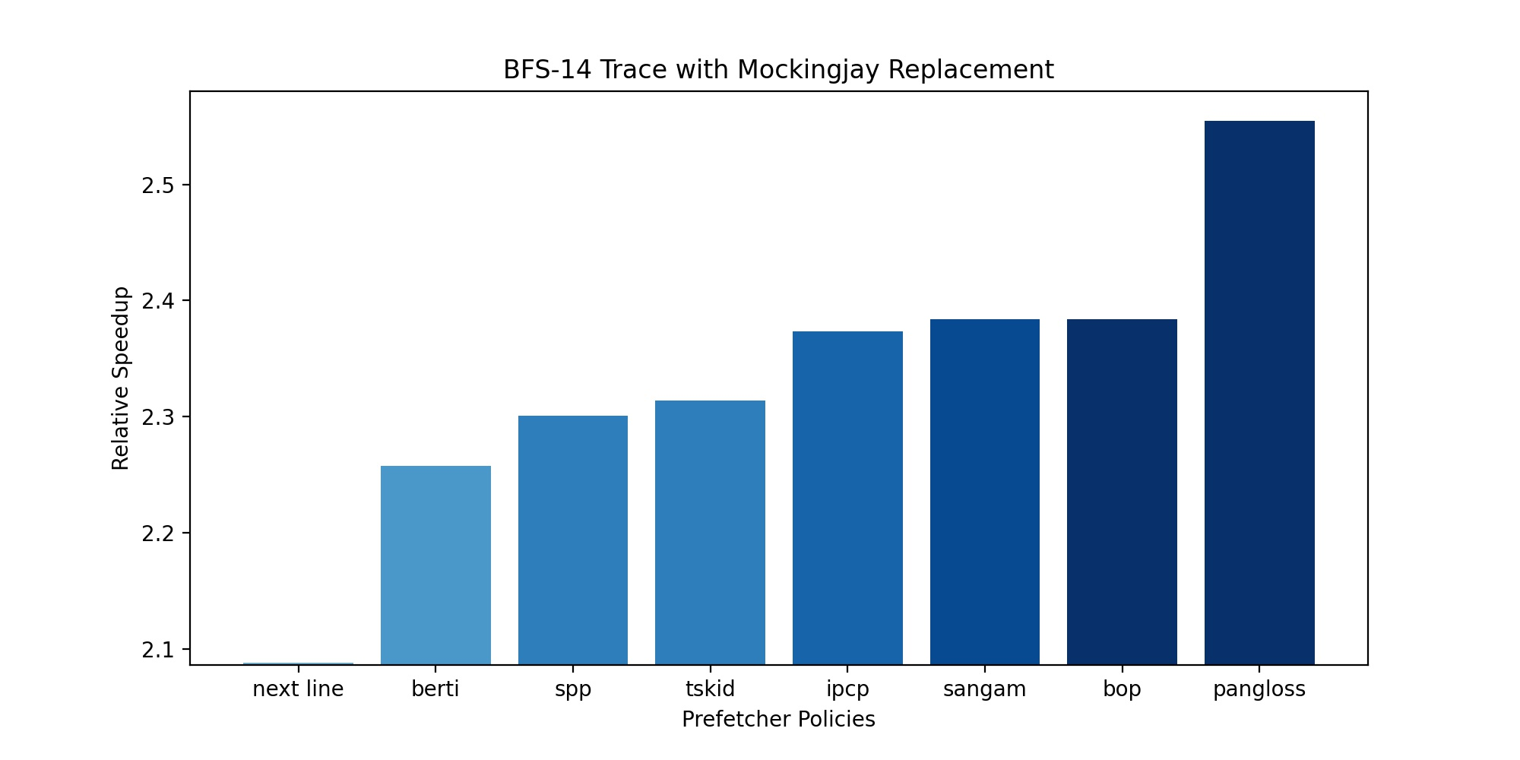
ChampSim ChampSim on the wall, tell me which prefetcher is the best of them all?

Slide 14

BOP Idea 1: Non-timely
Remove delay queue
BOP Idea 2: Fetch More
Increase prefetch degree

Slide 15
BOP Idea 3: Multiple
Increase the number of candidate offsets tested per iteration
BOP Idea 4: Foresight
Increase prefetch distance

Slide 16
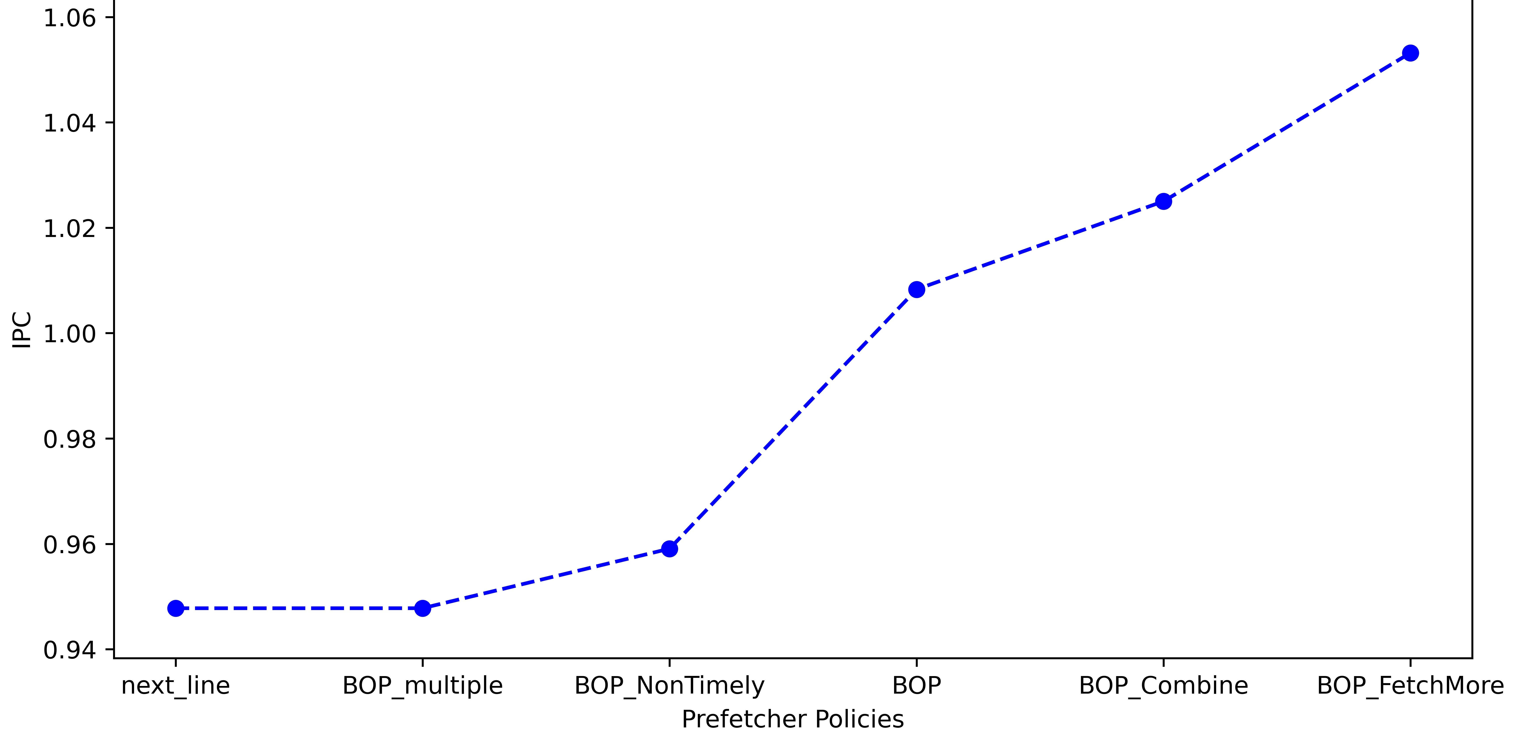

The Winner : Fetch More

Slide 17
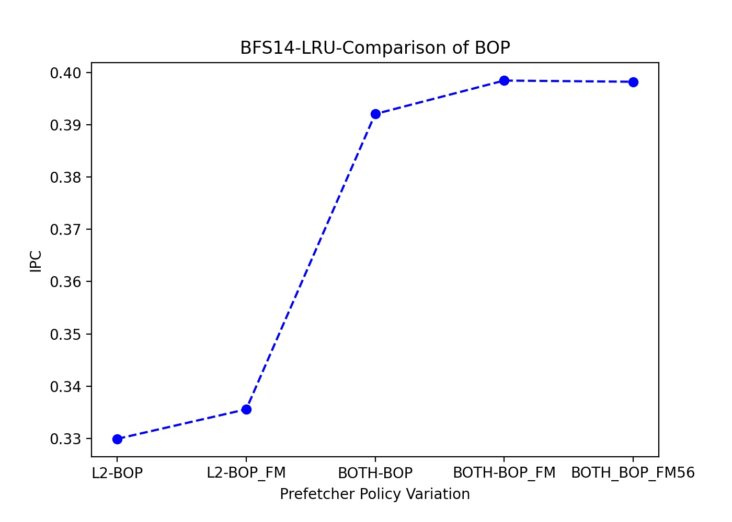
Best config : BOP_FM in L2 & LLC

Slide 18
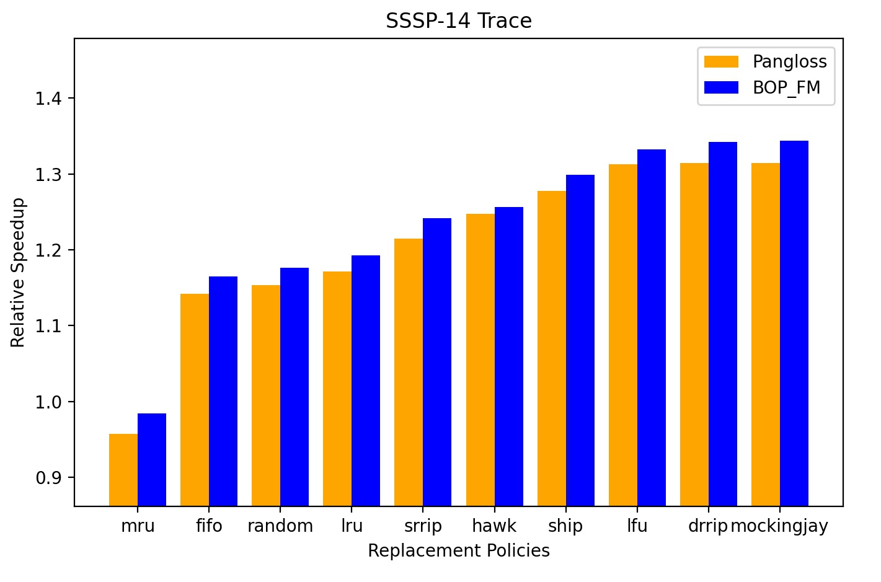
Pangloss vs Improved BOP
Improved BOP_FM worked better 🤩

Slide 19
Specializing Cache Replacement Policies for Graph Analytics
A person who never made a mistake, never tried anything new. Sounds familiar?

Slide 20


Improving Hawkeye
#Idea 1
Changed the way hawkeye deals with absence cache averse line
Tried using FIFO, LFU instead of the default LRU that Hawkeye uses

Slide 21
Improving Hawkeye
#Idea 2
Tried reducing memory traffic
Treated demand and prefetch access the same for determining the Bellady cache occupancy

Slide 22

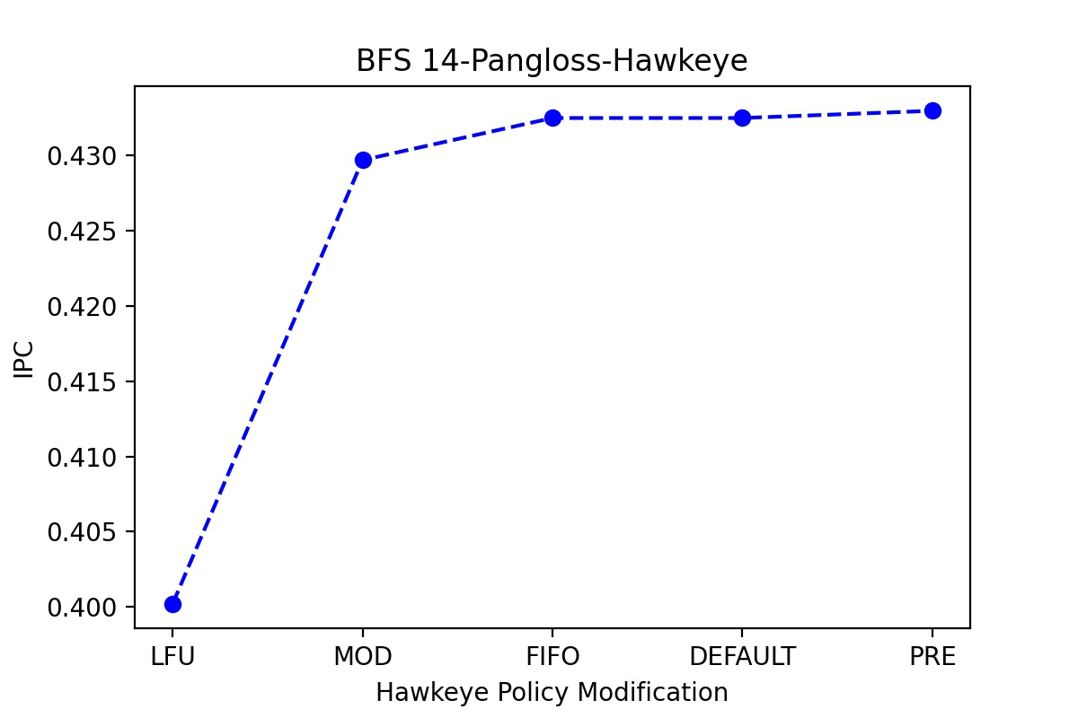
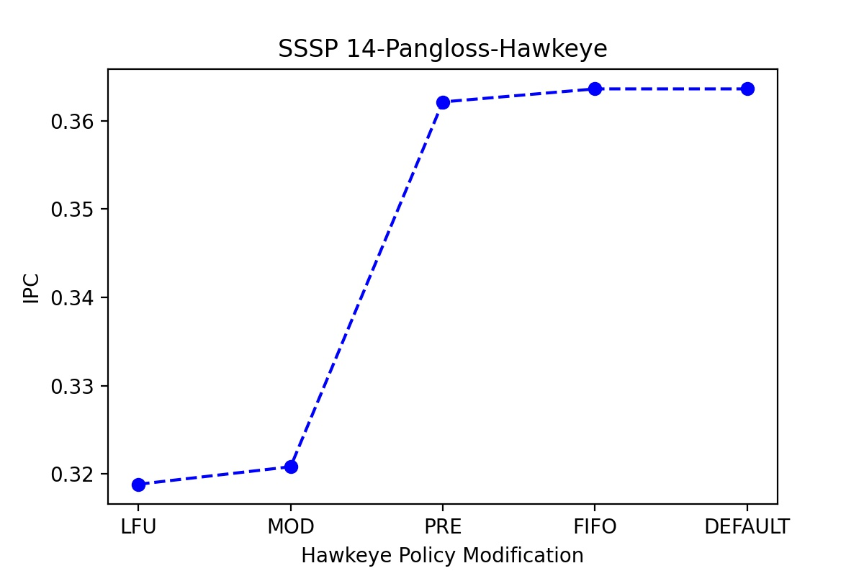
Failure quantified!!

Slide 23


Biswa:

Slide 24

Improving Hawkeye
#Idea 3
Increasing cache associativity
Changed LLC associativity while keeping cache size constant

Slide 25

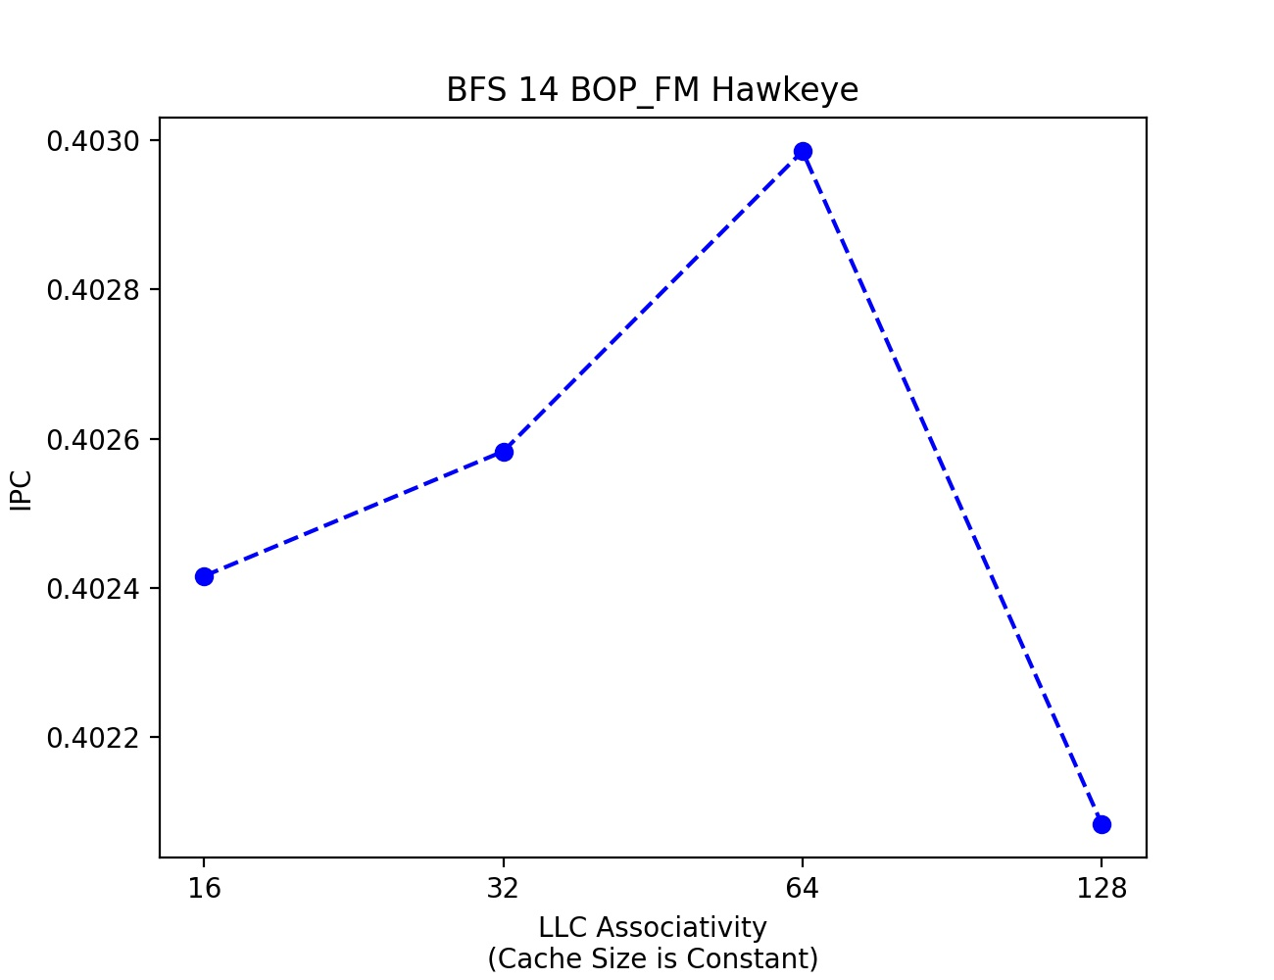
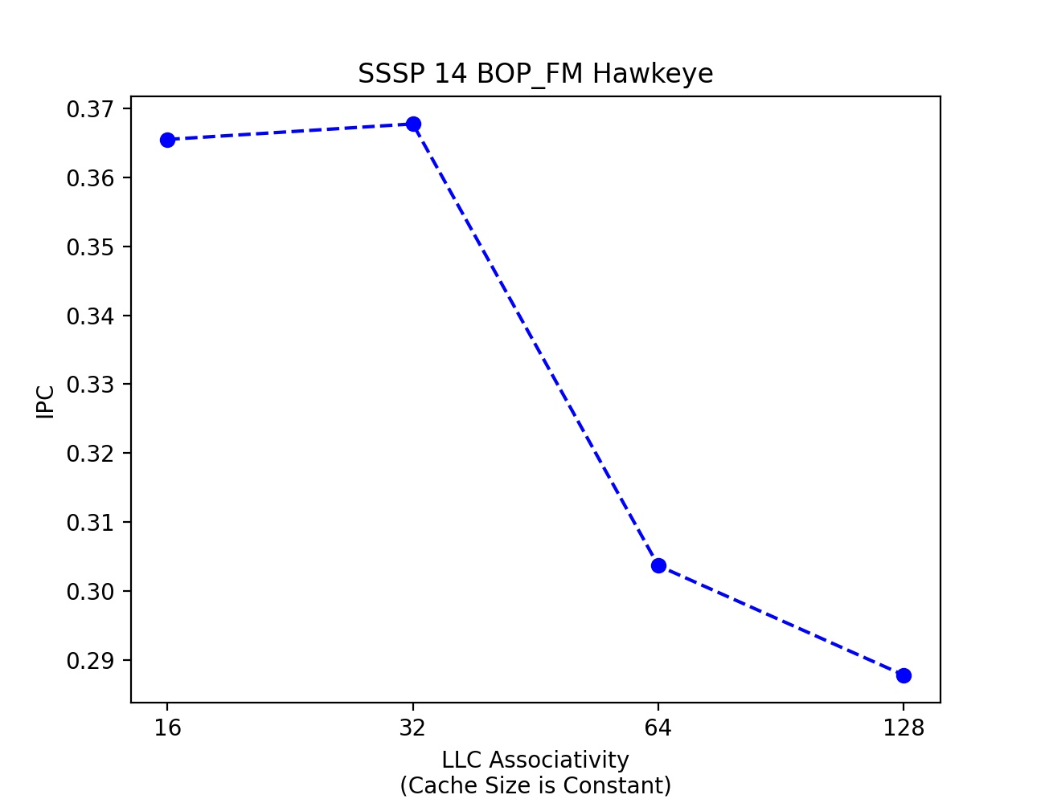
It works!!

Slide 26
Future prospect
Prefetch aware non-heuristic policies in the absence of cache averse lines are expected to perform better

Slide 27


Ruko zara! Sabar karo! We aren't done yet Optimizations in Mockingjay ahead
# Idea 1:
Changing Penalty Factor
Ignore redundant prefetches to maximize cache utilization

Slide 28
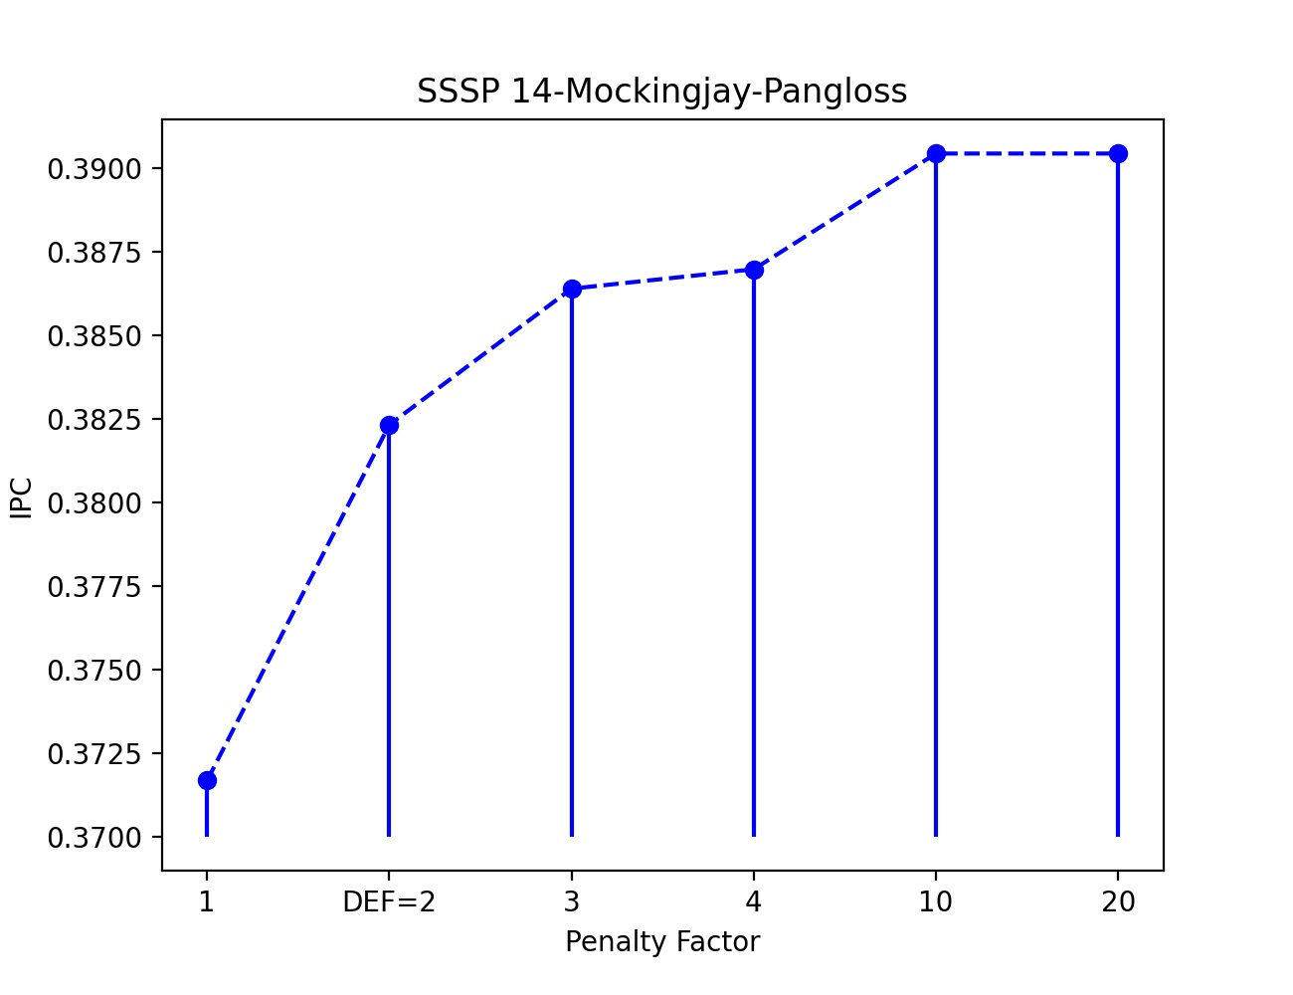
Penalty Factor Variation Results

Slide 29
Optimizations in Mockingjay
# Idea 2 :
Increasing eviction priority of blocks with largest ETR (Estimated Time Remaining)
Decreased MAX_RD

Slide 30
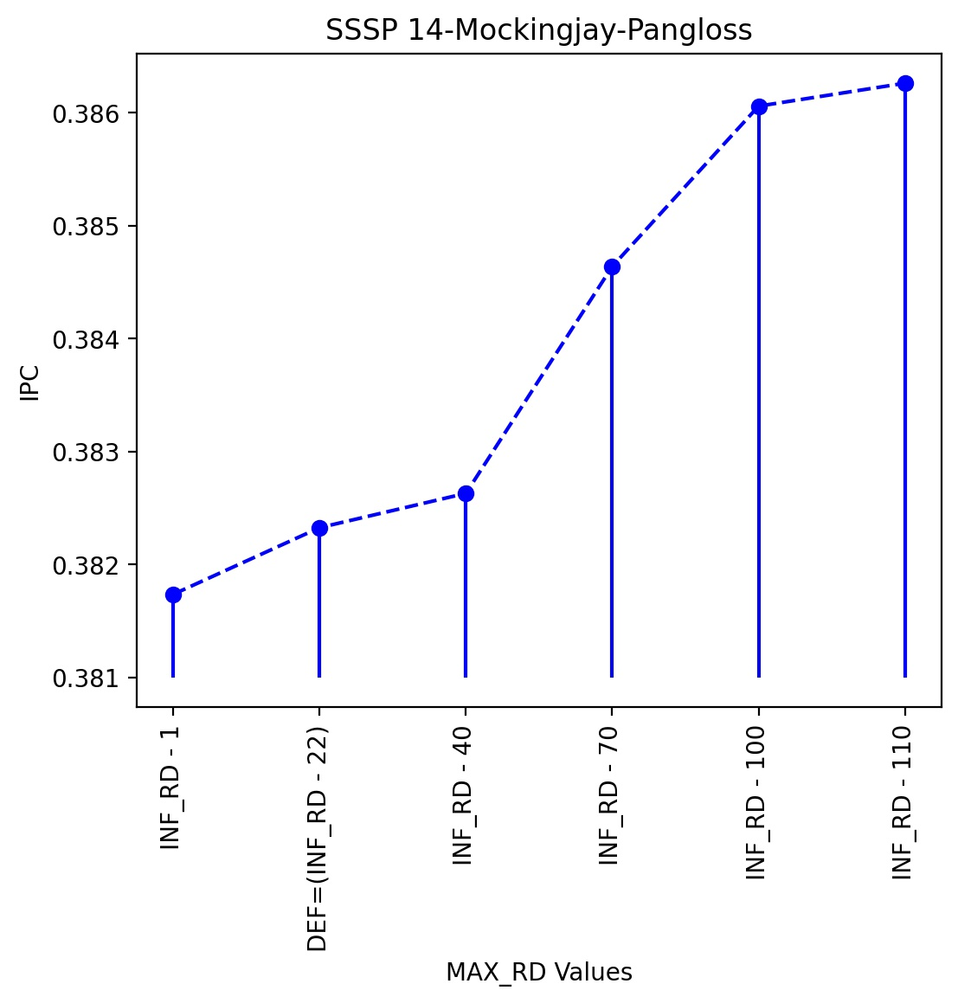

Slide 31
Future prospect
Changing prefetch granularity
Different kind of adaptive miss filter ( hit filter/ time-based filter)

Slide 32
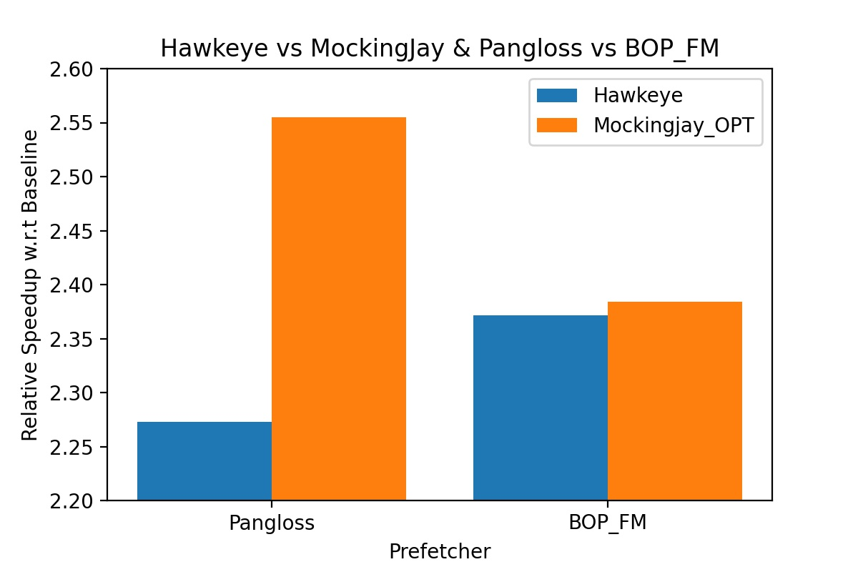

Now, comparing the best among the two
Optimized Mockingjay performed better than hawkeye

Slide 33
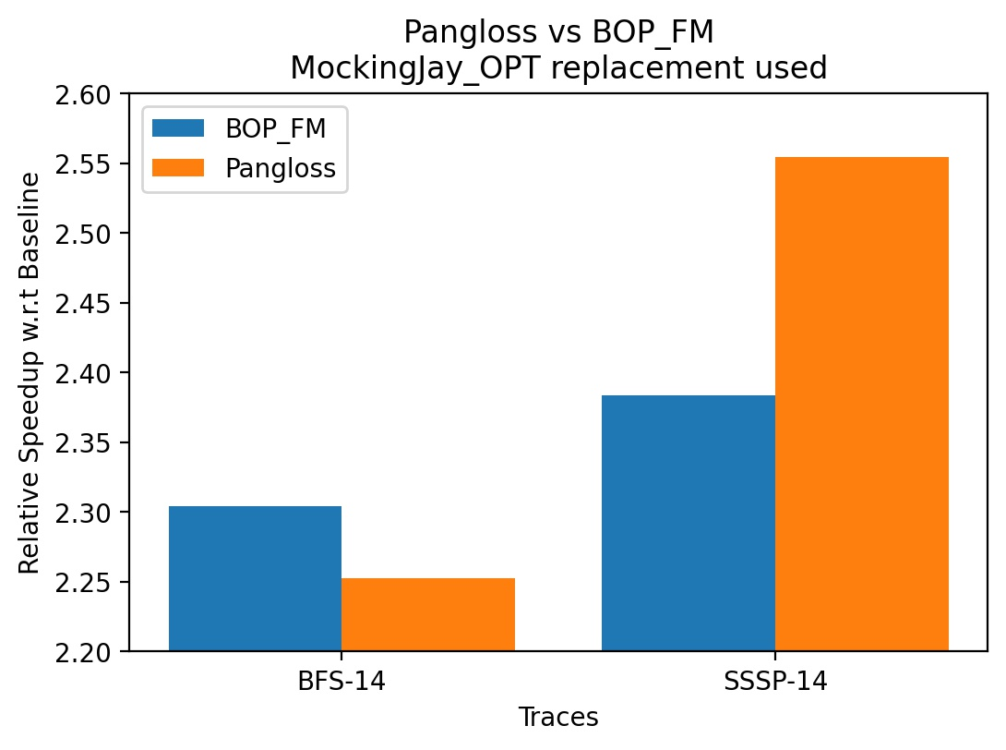

Comparing prefetchers
It is trace dependent. BOP_FM performed better for BFS trace whereas Pangloss performed better for SSSP trace

Slide 34





Thankyou Biswa and the TAs☺ We bid adieu to this amazing course ☹

